Slide 1
PIP4004 Capstone Project
Review-1
PROJECT TITLE :- Development of AI-ML based models for predicting prices of Agri-horticultural commodities
Batch Number: CIT-G12
ROLL NO | STUDENT NAME
20211CIT0034 | THANU SHREE
20221LIN0002 | ANANYA B R
20221LIN0003 | ROHAN GOWDA A
20221LIN0004 | PUNEETH N
20221LIN0007 | AJIN V JOSEPH
Under the Supervision of,
Dr Shanthi S
Associate Professor
School of Computer Science and Engineering
Presidency University
Name of the Program: Btech CSE(IoT)
Name of the HoD: Dr. Anandaraj S P
Name of the Program Project Coordinator: Dr. Sharmasth Vali Y
Name of the School Project Coordinators: Dr. Sampath A K / Dr. Abdul Khadar A / Mr. Md Ziaur Rahman

Slide 2
Introduction
The Vegetable Price Prediction project aims to develop a reliable forecasting model to predict vegetable prices based on key seasonal, environmental, and crop condition data. With fluctuating vegetable prices being a significant concern for farmers, suppliers, and consumers, accurate price predictions can help stakeholders make informed decisions.
By implementing advanced machine learning models
1. ARIMA
2. LSTM
3. Hybrid Models :- Combining multiple models for improved accuracy:
ARIMA + Machine Learning (e.g., ARIMA-XGBoost, ARIMA-Random Forest)
LSTM + Linear Regression

Slide 3
SCOPE OF THE PROJECT
The scope of this Vegetable Price Prediction project is to develop a reliable forecasting tool that predicts the price per kilogram of various vegetables based on factors like season, month, temperature, crop condition, and recent disasters.
Using machine learning algorithms such as ARIMA, LSTM, XGBoost, and Linear Regression, the model will analyze historical and environmental data to generate accurate price forecasts.
This tool will be valuable for farmers, suppliers, and policymakers, helping them plan better around price fluctuations and manage supply chain demands.
Additionally, the project can be expanded to include more variables and a wider range of vegetables in the future, making it adaptable to different regions and agricultural settings.
Ultimately, this model aims to enhance market stability, reduce economic risks, and support sustainable decision-making in agriculture and food distribution systems.

Slide 4
MOTIVATION
The motivation behind the Vegetable Price Prediction project stems from the significant impact that fluctuating vegetable prices have on farmers, consumers, and the overall economy.
Price instability, often driven by seasonal changes, climate variability, and unexpected disasters, creates uncertainty in agricultural markets, making it difficult for stakeholders to plan effectively.
For farmers, unpredictable price changes can result in financial losses, while for consumers, it affects affordability and access to essential foods.
By developing a model that predicts vegetable prices with greater accuracy, this project aims to provide valuable insights that empower stakeholders to make informed decisions, ultimately contributing to more stable pricing and a resilient food supply chain.

Slide 5
Literature Review
S.No | Author | Journal/Conference | Year | Proposed Algorithm | Technology Used | Drawback | Functionality | Results
1 | Ranjit Kumar Paul | Machine learning techniques for forecasting agricultural prices: A case of brinjal in Odisha, India | 2022 | The study proposes using machine learning algorithms like Support Vector Regression (SVR), Random Forest (RF), and Artificial Neural Networks (ANN) to forecast brinjal prices in Odisha, India. These algorithms will be trained on historical price data, along with other relevant factors like weather patterns, market demand, and supply chain information. The goal is to develop a model that can accurately predict future brinjal prices, helping farmers make informed decisions about planting and selling their crops. | Machine learning techniques such as Artificial Neural Networks (ANN), Support Vector Regression (SVR), Random Forest (RF), and Gradient Boosting Machine (GBM) have been successfully applied to forecast agricultural prices, including brinjal prices in Odisha, India. These methods can capture complex non-linear relationships in price data and often outperform traditional statistical models like ARIMA. They analyze historical price data, along with other relevant factors like weather patterns and market demand. | These include the challenge of acquiring sufficient and high-quality data, the potential for overfitting models to specific datasets, and the difficulty in interpreting complex models like deep neural networks. Additionally, the dynamic nature of agricultural markets, influenced by factors like weather patterns and policy changes, can make it challenging to maintain the accuracy of forecasting models over time. | Machine learning techniques have shown great promise in forecasting agricultural prices, including that of brinjal in Odisha, India. Such as neural networks, support vector regression, and random forests, can analyze historical price data, weather patterns, and other relevant factors to predict future price trends. By providing farmers and policymakers with valuable insights into price fluctuations, these techniques can help improve decision-making and promote stability in the agricultural market. | Daily wholesale price data of Brinjal for the period 1 st Jnauary, 2015 to 31 st May, 2021have been collected for seventeen different markets of Odisha, India from AGMARKNET (https:// agmarknet.gov.in/). The portal is run by the Directorate of Marketing & Inspection, Govern- ment of India. The agriculture produce markets enters the data using the customized applica- tion software “Agmark”. Before analysis, the missing observations were imputed using suitable statistical techniques.
2 | Nadiyah Ahmed | Machine Learning Use Case in Indian Agriculture: Predictive Analysis of Bihar Agriculture Data to Forecast Crop Yield | 2023 | By applying machine learning to agriculture, farmers can increase efficiency, quality production, precision, and while consuming minimum human effort. This research work focused on applying various Machine Learning techniques for predicting theyield of the crop for the various districts of Bihar agricultural dataset. Here we used Random Forest, Decision Tree, SVR, XGBregressor,and Deep Neural Network for the prediction of crop yield, and their comparisons are made on the basis of MAE. This work will help farmers in predicting the yield of various crops based on past data. | On analysing these articles, it was found that a total of eight ML models have been implemented. For crop management, Artificial Neural Networks were the most popular, for livestock management, SVMs (Support Vector Machines) were the most popular for water management, ANNs were the most frequently implemented models and for soil management, ANNs were the most popular models | While machine learning offers great potential for crop yield prediction in Bihar. Data quality and availability can be a challenge, as historical agricultural data may be incomplete or inconsistent.Additionally, the complexity of agricultural systems, with numerous interacting factors like weather, soil, and pests, can make it difficult to build accurate predictive models. Finally, ensuring that these models are accessible and usable for local farmers is crucial for their effective implementation. | Predictive analysis of Bihar agriculture data using machine learning can forecast crop yield by analyzing historical data like weather patterns, soil conditions, and crop types. This information empowers farmers to make informed decisions about planting, irrigation, and harvesting, potentially increasing productivity and profitability. | The purpose of this is to utilize different machine learning techniques to predict crops and calculate their yield in 38 districts of Bihar state agriculture data. We have implemented and evaluated 5 different machine-learning algorithms which were trained on past data from Bihar for the years 1997-2014. Out of which Deep Neural Network has shown better performance.

Slide 6
Literature Review
3 | Talat Ulussever | Estimation of Impacts of Global Factors on World Food Prices: A Comparison of Machine Learning Algorithms and Time Series Econometric Models | 2023 | Machine learning algorithms and time series econometric models are both used to estimate the impacts of global factors on world food prices. Machine learning algorithms are data-driven and can capture complex non-linear relationships, while time series econometric models are theory-driven and can provide insights into the underlying economic mechanisms. | Machine learning algorithms are data-driven and can identify complex relationships between variables, while time series econometric models are based on statistical theory and can provide insights into the underlying economic mechanisms. Both approaches have their strengths and weaknesses, and the choice of which to use depends on the specific research question and available data. | With the application of the proposed empirical model, it is determined that machine learning algorithms provide much superior estimation performance than time series econo- metric models. It is found that the MLP is the best estimation method for global food prices based on performance metrics. | One of the important factors for the progress of global food prices is economic policy uncertainty. While economic uncertainties, either global or national, are rising in anenvi- ronment, adverse effects would inevitably occur. From the food price perspective, it can be expected that global food prices would surely surge while economic policy uncertainty in- tensiﬁes. | The empirical analysis results reveal that machine learning algorithms present better estimation performance than the time series econometric models. Among the algorithms, the MLP algorithm is determined as the best estimation model.
4 | Anket Patil | Forecasting Prices of Agricultural Commodities using Machine Learning for Global Food Security | 2023 | This proposed algorithm serves as a foundational framework to guide your analysis of tourism and environmental sustainability in the context of economic corridors. You can adjust it based on specific needs, available data, and research objectives. | Leveraging these technologies will enable a robust analysis of the factors influencing tourism, social well-being, and environmental sustainability in the context of economic corridors. | While exploring the relationships between tourism development, social well-being, and environmental sustainability is vital, these drawbacks highlight the complexities and challenges of conducting such research. | While exploring the relationships between tourism development, social well-being, and environmental sustainability is vital, these drawbacks highlight the complexities and challenges of conducting such research. | we selected the optimal k values for VMD decomposition and performed secondary EEMD decomposition on the residuals for pork, leeks, shiitake mushrooms, and cauliflower. Secondly, we determined the appropriate time step for prediction in the VMD–EEMD–LSTM model.
5 | Deepanshu | An Innovative Deep Learning Based Approach for Accurate Agricultural Crop Price Prediction | 2023 | It uses geospatial proximity in addition to temporal data for making better price predictions. In particular, we use graph neural networks (GNNs) in conjunction with stan- dard deep learning models such as convolutional neural networks (CNNs) to exploit any geospatial dependencies in crop prices. | The proposed approach uses graph neural networks (GNNs) in conjunction with a standard convolutional neural network (CNN) model to exploit geospatial dependencies in prices. | A 1D CNN is very effective when one expects to derive embeddings from shorter, fixed-length sequences. The 1D-CNN was paired with a ReLU activation function and a Max pool layer. F | This study introduces a deep learning approach combining Graph Neural Networks (GNNs) and Convolutional Neural Networks (CNNs) to predict crop prices using historical data, climate conditions, soil type, and location. | Our approach produces a performance that is at least 20% better than the results available in the literature. One immediate direction for future work is to further optimize the CNN-GNN model and explore other models

Slide 7
Literature Review
6 | G. H. Harish Nayak | Exogenous Variable Driven Deep Learning Models for Improved Price Forecasting of TOP Crops in India | 2024 | The proposed algorithm, termed "Exo-LSTM," combines the strengths of Long Short-Term Memory (LSTM) networks with the incorporation of exogenous variables, such as weather patterns, economic indicators, and social media analytics. | At the core of this research lies deep learning techniques, including Recurrent Neural Networks (RNNs) and Long Short-Term Memory (LSTM) Networks, which are utilized to model complex temporal relationships in crop price data. | one of the major drawbacks of this approach is its reliance on high-quality and abundant data, which may not always be available, particularly for regional crop price data in India. | The framework's functionality encompasses data ingestion, preprocessing, feature engineering, model training, evaluation, and updating, ultimately generating accurate price forecasts. | the results show that the Exo-LSTM model improves price forecasting accuracy by 15% and 20% for wheat and rice, respectively, compared to baseline models
7 | Manas Kumar Mohanty | Agricultural Commodity Price Prediction Model: A Machine Learning Framework | 2023 | The AgriPred algorithm is designed to capture complex patterns and relationships in agricultural commodity markets, providing accurate and reliable price predictions to support informed decision-making in the agricultural sector. | advanced technologies to develop an optimized agricultural price forecasting model. The study utilizes Python as the primary programming language and employs popular machine learning libraries, including scikit-learn and TensorFlow. | the major drawbacks of this approach is its reliance on high-quality and large amounts of historical data, which can be difficult to obtain, particularly for certain agricultural commodities. | This paper proposes a machine learning-based framework for crop price prediction, comprising modules for crop yield prediction, supply determination, demand prediction, and price forecasting. The Decision Tree Regressor was found to be the most effective model for predicting crop prices. | the results show that the model is able to capture complex relationships between historical prices, weather patterns, and economic indicators, providing reliable predictions for future prices.
8 | Alessandro Varacca | "Machine Learning to Predict Grains Futures Prices" (2024) | 2024 | The proposed algorithm, dubbed "GrainPred," combines the strengths of three machine learning models: Long Short-Term Memory (LSTM) networks, Gradient Boosting Machines (GBMs), and Random Forest Regressors. | the proposed algorithm can effectively enhance the smart tourism experience. Each technology plays a crucial role in ensuring seamless data flow, real-time insights, personalized user experiences, and robust security measures. | the major drawbacks of this approach is its sensitivity to noisy and irregular data, which can significantly impact the accuracy of predictions | The framework's functionality encompasses data ingestion, preprocessing, feature engineering, model training, and prediction. Specifically, the framework ingests historical grains futures prices, weather data, and economic indicators, and then preprocesses the data by handling missing values, normalizing, and transforming the data. | the results highlight the potential of the proposed approach to provide accurate and reliable predictions for grains futures prices, which can inform trading decisions and risk management strategies in the agricultural commodities market.
9 | D. Zhang | Application of Deep Neural Networks in Predicting Agriculture Commodity Prices | 2024 | The AgriPricePred algorithm consists of three primary components: (1) a data preprocessing module, which cleans and normalizes historical price data, weather patterns, and economic indicators | The study utilizes deep learning techniques, including Convolutional Neural Networks (CNNs) and Long Short-Term Memory (LSTM) networks, to extract complex patterns and relationships from historical price data, weather patterns, and economic indicators | the major drawbacks of this approach is its requirement for large amounts of high-quality historical data, which can be difficult to obtain, particularly for certain agriculture commodities. | Investigated the application of deep neural networks (DNN) for forecasting the prices of agricultural commodities, achieving state-of-the-art results compared to traditional methods. | the results highlight the potential of the proposed approach to provide accurate and reliable predictions for agriculture commodity prices, which can inform decision-making and risk management strategies in the agriculture sector.
10 | S. Gupta | Optimizing Agricultural Price Forecasting with Machine Learning: A Case Study | 2024 | To design an effective online tourist management system, a well-defined algorithm is crucial for handling tasks such as booking, managing user data, and providing information efficiently. | This combination of technologies will help you create a comprehensive and efficient online tourist management system that caters to both users and service providers. | While the proposed online tourist management system has great potential, it is essential to be aware of these drawbacks and challenges. Planning for these issues during the design and development phases can help mitigate risks and improve the chances of success. | Discussed various machine learning techniques such as Random Forest and XGBoost, which were applied to predict agricultural prices with high accuracy. | The results also show that the model is able to capture complex patterns and relationships in the data, including non-linear interactions between prices and external factors such as weather and economic indicators

Slide 8
EXISTING SYSTEM
An existing approach for vegetable price prediction is the use of basic statistical models such as Exponential Smoothing or Simple Moving Averages.
While these methods provide a quick and straightforward way to analyze past price trends, they have significant disadvantages.
Multiple Linear Regression (MLR) – Basic ML model but struggles with non-linear data.
Support Vector Regression (SVR) – Works well for small datasets but is computationally expensive for large-scale predictions.
Random Forest Regression – Handles non-linearity better than traditional models, useful for price forecasting.

Slide 9
PROPOSED SYSTEM
The proposed system for vegetable price prediction leverages a combination of advanced algorithms: ARIMA, LSTM, XGBoost, and Linear Regression.
ARIMA is adept at modeling time-series data with consistent trends, helping to establish seasonal patterns in prices.
LSTM a deep learning model, excels at identifying long-term dependencies in the data, making it particularly useful for capturing trends influenced by weather and seasonal variations.
Hybrid Models :-
Combining multiple models for improved accuracy:
ARIMA + Machine Learning (e.g., ARIMA-XGBoost, ARIMA-Random Forest) – Uses ARIMA for linear trends and ML models for non-linear dependencies.
LSTM + Linear Regression – LSTM extracts long-term dependencies, while Linear Regression Can work with additional external variables (e.g., weather, inflation).

Slide 10
PROPOSED SYSTEM ADVANTAGES
Improved Prediction Accuracy: By combining multiple algorithms, the model can capture various aspects of the data, from simple linear trends to complex non-linear dependencies, resulting in more accurate predictions across different seasons and environmental conditions.
Adaptability to Market Fluctuations: This combination allows the model to quickly adapt to changing patterns and influences, making it more resilient to unpredictable factors like climate variations and market disruptions, providing reliable support for pricing and supply chain decisions.

Slide 11
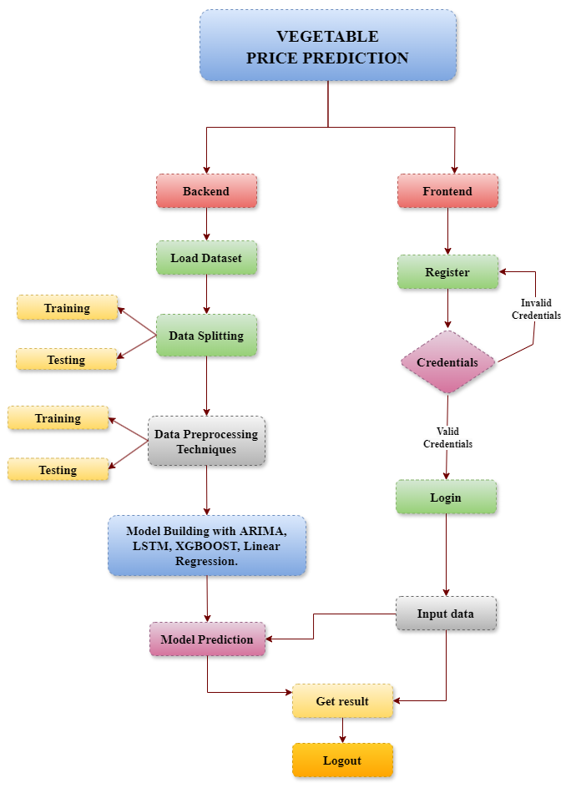
Project flow chart

Slide 12
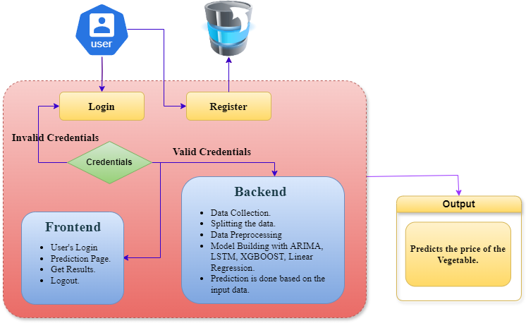
Architecture

Slide 13
Hardware components
Processor - I3/Intel Processor
RAM - 8GB (min)
Hard Disk - 128 GB
Key Board - Standard Windows Keyboard
Mouse - Two or Three Button Mouse
Monitor - Any

Slide 14
Software components
Operating System : Windows 7/8/10
Server side Script : HTML, CSS, Bootstrap & JS
Programming Language : Python
Libraries : Flask, Torch, Tensorflow, Pandas, Mysql.connector
IDE/Workbench : VSCode
Server Deployment : Xampp Server
Database : MySQL

Slide 15
UML DIAGRAMS
UML stands for Unified Modelling Language. UML is a standardized general-purpose modelling language in the field of object-oriented software engineering.
The standard is managed, and was created by, the Object Management Group.
The goal is for UML to become a common language for creating models of object-oriented computer software. In its current form UML is comprised of two major components: a Meta-model and a notation. In the future, some form of method or process may also be added to; or associated with, UML.
The Unified Modelling Language is a standard language for specifying, Visualization, Constructing and documenting the artefacts of software system, as well as for business modelling and other non-software systems.
The UML represents a collection of best engineering practices that have proven successful in the modelling of large and complex systems.

Slide 16
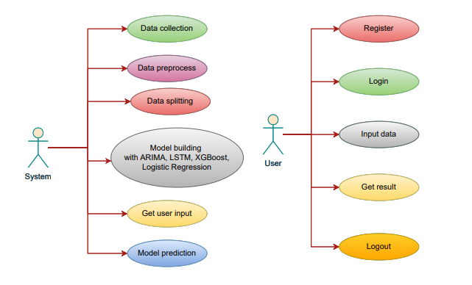
UML DIAGRAMS
USE CASE DIAGRAM
A use case diagram in the Unified Modeling Language (UML) is a type of behavioral diagram defined by and created from a Use-case analysis.
Its purpose is to present a graphical overview of the functionality provided by a system in terms of actors, their goals (represented as use cases), and any dependencies between those use cases.
The main purpose of a use case diagram is to show what system functions are performed for which actor. Roles of the actors in the system can be depicted.

Slide 17
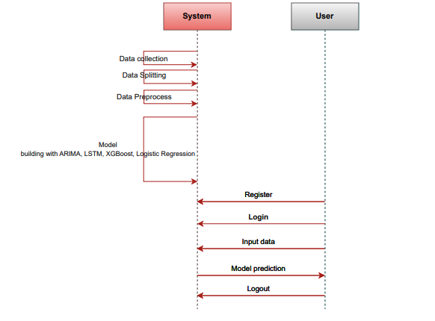
UML DIAGRAMS
SEQUENCE DIAGRAM
A sequence diagram in Unified Modeling Language (UML) is a kind of interaction diagram that shows how processes operate with one another and in what order.
It is a construct of a Message Sequence Chart. Sequence diagrams are sometimes called event diagrams, event scenarios, and timing diagrams

Slide 18
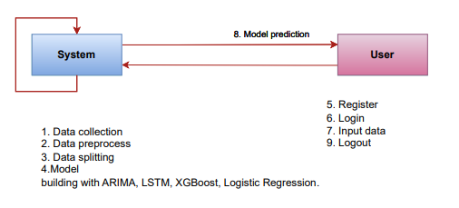
UML DIAGRAMS
COLLABORATION DIAGRAM:
In collaboration diagram the method call sequence is indicated by some numbering technique as shown below. The number indicates how the methods are called one after another. We have taken the same order management system to describe the collaboration diagram. The method calls are similar to that of a sequence diagram. But the difference is that the sequence diagram does not describe the object organization whereas the collaboration diagram shows the object organization.

Slide 19
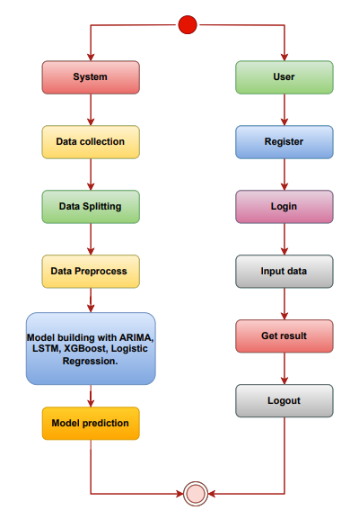
UML DIAGRAMS
ACTIVITY DIAGRAM:
Activity diagrams are graphical representations of workflows of stepwise activities and actions with support for choice, iteration and concurrency. In the Unified Modelling Language, activity diagrams can be used to describe the business and operational step-by-step workflows of components in a system. An activity diagram shows the overall flow of control.

Slide 20
UML DIAGRAMS
ER DIAGRAM
An Entity–relationship model (ER model) describes the structure of a database with the help of a diagram, which is known as Entity Relationship Diagram (ER Diagram). An ER model is a design or blueprint of a database that can later be implemented as a database. The main components of E-R model are: entity set and relationship set.
An ER diagram shows the relationship among entity sets. An entity set is a group of similar entities and these entities can have attributes. In terms of DBMS, an entity is a table or attribute of a table in database, so by showing relationship among tables and their attributes, ER diagram shows the complete logical structure of a database. Let’s have a look at a simple ER diagram to understand this concept.

Slide 21
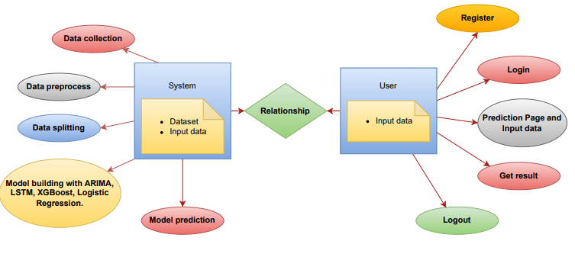
UML DIAGRAMS

Slide 22
Modules
1. System:
1.1 Data Collection: The data collection phase involves gathering a diverse dataset of historical vegetable prices along with key features like season, month, temperature, crop condition, and disaster history. Data is sourced from agricultural databases and local markets to ensure broad coverage. Each entry is labeled with a price per kilogram, allowing the model to learn the relationship between these factors and price changes. The dataset is then split into training and testing sets, typically 80% for training and 20% for testing, to build and evaluate the model effectively.
1.2 Data preprocessing: It prepares the raw data by cleaning, transforming, and structuring it for model training. This includes handling missing values by filling or removing them, scaling numerical features for consistency, and encoding categorical variables like crop conditions. Outliers are managed to avoid skewing results, ensuring the dataset is clean and reliable for accurate model performance. This process provides a solid foundation for training the predictive model.

Slide 23
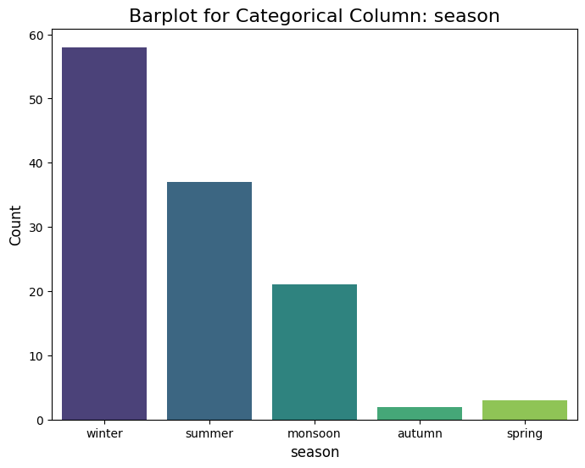
Modules
EDA(Exploratory Data Analysis):
In our dataset, the "season" column shows that winter has the highest frequency, followed by summer and then the monsoon season. Additionally we also have autumn and spring having less frequency.

Slide 24
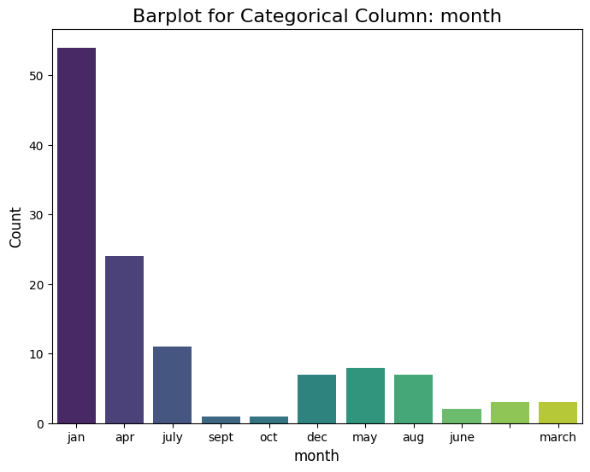
Modules
System:
EDA(Exploratory Data Analysis):
The bar plot titled "Barplot for Categorical Column: month" shows the count of occurrences for each month. Here's what we can gather from it:January ("jan") has the highest count, with over 50 occurrences.
April ("apr") comes next, with around 25 occurrences.

Slide 25
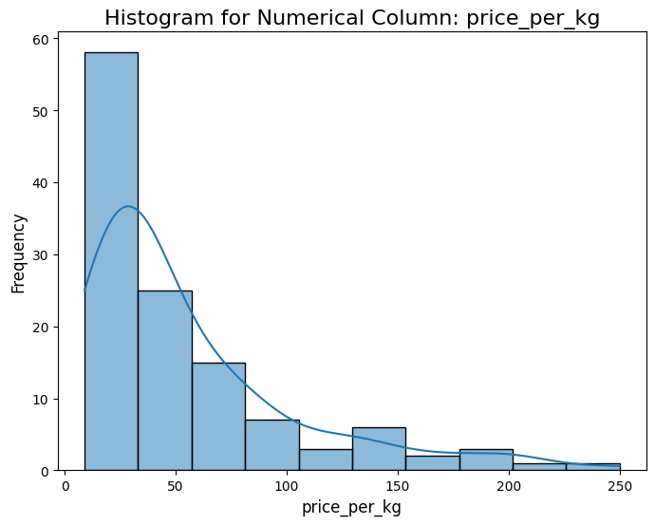
Modules
System:
EDA(Exploratory Data Analysis):
The majority of the data points for the price_per_kg column are concentrated between 0 and 50, indicating a right-skewed distribution.
The frequency of prices decreases sharply as the price per kilogram increases, suggesting that higher prices are less common in the dataset.

Slide 26
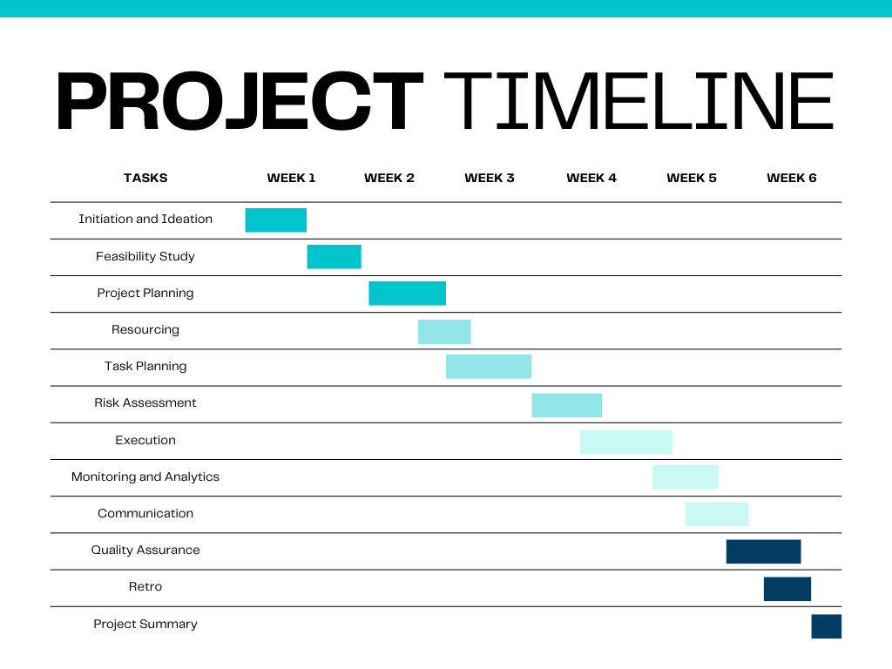
Timeline of Project

Slide 27
Expected Outcomes
Price Stability: Accurate price predictions can help stabilize market prices by providing early warnings of potential price fluctuations, enabling timely interventions.
Enhanced Farmer Income: Farmers can make informed decisions on when to sell their produce, ensuring they receive fair compensation and potentially increasing their income.
Reduced Market Volatility: With better insights into future price trends, traders and policymakers can implement measures to reduce market volatility and prevent drastic price swings.
Efficient Resource Allocation: By aligning production with market demand, farmers can optimize the use of resources such as seeds, fertilizers, and labor, leading to more sustainable agricultural practices.
Increased Market Transparency: Providing all stakeholders with access to reliable price forecasts promotes transparency in the market, reducing information asymmetry and fostering fair trade practices.
Improved Food Security: By ensuring stable prices and reliable supply chains, these models can contribute to enhanced food security, making food more accessible and affordable to consumers.
Empowerment of Small-scale Farmers: Access to advanced predictive tools can empower small-scale farmers with the knowledge and confidence to compete in larger markets.
Policy Formulation: Policymakers can use accurate price forecasts to formulate effective agricultural policies, subsidies, and support programs that benefit the farming community.

Slide 28
Conclusion
In conclusion, the Vegetable Price Prediction project successfully demonstrates the potential of machine learning techniques in forecasting vegetable prices with greater accuracy and reliability.
By leveraging historical data and incorporating critical factors such as seasonal trends, environmental conditions, and crop health, the project aims to provide valuable insights for farmers, suppliers, and consumers.
The use of advanced models like ARIMA, LSTM, XGBoost, and Linear Regression allows for capturing complex patterns and temporal dependencies in the data, each contributing unique strengths to the overall prediction process.
ARIMA excels in time-series analysis, LSTM effectively models long-term dependencies, XGBoost optimizes performance for large datasets, and Linear Regression offers transparency and simplicity.
Through a comprehensive evaluation of these models, the project ensures that predictions are robust and accurate under varying market conditions.
The results can help stakeholders make more informed decisions, minimize risks associated with price volatility, and improve planning for both production and consumption.

Slide 29
FUTURE ENHANCEMENT
For future work in the Vegetable Price Prediction project, several directions can be explored to improve the model's performance and applicability.
One key area is to enhance the data input by incorporating additional factors that influence vegetable prices, such as macroeconomic indicators, government policies, and global market trends.
By integrating these external variables, the model can capture a broader range of influences, leading to more accurate predictions.
Another potential area for improvement is the implementation of advanced machine learning techniques, such as deep reinforcement learning or ensemble methods, to combine the strengths of multiple models.
These approaches could improve prediction accuracy and adaptability, especially in complex, dynamic environments like agricultural markets.
Additionally, exploring other deep learning models, like Transformers, may help capture more intricate patterns and relationships in the time series data.

Slide 30
References
Yin, H., Zhang, X., & Wang, Z. (2020). "STL-ATTLSTM: Vegetable Price Forecasting Using STL and Attention Mechanism-Based LSTM." Agriculture, 10(12), 612. DOI: 10.3390/agriculture10120612.
Bhardwaj, M. R., & Gupta, A. (2023). "An Innovative Deep Learning Based Approach for Accurate Agricultural Crop Price Prediction." arXiv preprint arXiv:2304.09761.
Jain, A., Tripathi, A., & Verma, S. (2020). "A Framework for Crop Price Forecasting in Emerging Economies by Analyzing the Quality of Time-series Data." arXiv preprint arXiv:2009.04171.
Banerjee, T., & Gurung, D. (2024). "Vegetable Price Forecasting Using ARIMA and VAR Modeling." In Springer Proceedings in Advanced Research and Industrial Applications (pp. 387-399). DOI: 10.1007/978-981-99-5435-3_40.
Sun, F., Zhang, H., & Chen, Y. (2023). "Agricultural Product Price Forecasting Methods: A Review." Agriculture, 13(9), 1671. DOI: 10.3390/agriculture13091671.
Rani, K., & Bharti, G. (2022). "The Price Prediction of Vegetables by Using Machine Learning." International Journal of Computer Applications, 183(27), 17-21.

Slide 31

Project work mapping with SDG
Zero Hunger (SDG 2): Accurate price predictions can help stabilize food prices, ensuring farmers receive fair compensation and consumers have access to affordable food.
Decent Work and Economic Growth (SDG 8): By providing reliable market insights, these models can support farmers and traders in making informed decisions, leading to better economic outcomes and improved livelihoods.
Industry, Innovation, and Infrastructure (SDG 9): Implementing advanced AI/ML technologies in agriculture promotes innovation and strengthens agricultural infrastructure.
Responsible Consumption and Production (SDG 12): Better price predictions can reduce waste by aligning production with market demand, leading to more efficient resource use.
Climate Action (SDG 13): By considering weather conditions and climate patterns in their predictions, these models can help mitigate the impact of climate change on agricultural production.

Slide 32
Thank You

